Slide 1

Vēsma
A simple solution to household air pollution

Slide 2
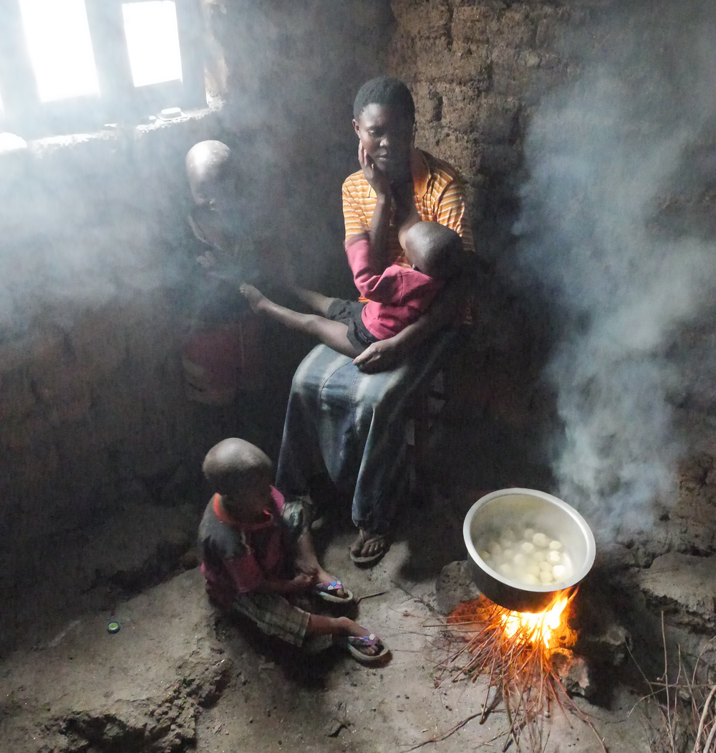
3BILLION
People worldwide still cook on open fires
4MILLION
People p/a die from illnesses related to household pollution
1/2
Of deaths due to pneumonia in children under 5 attributed to smoke inhalation
100MILLION
Additional people expected to use traditional cooking devices by 2030
Source: WHO 2018, SNV 2015

Slide 3
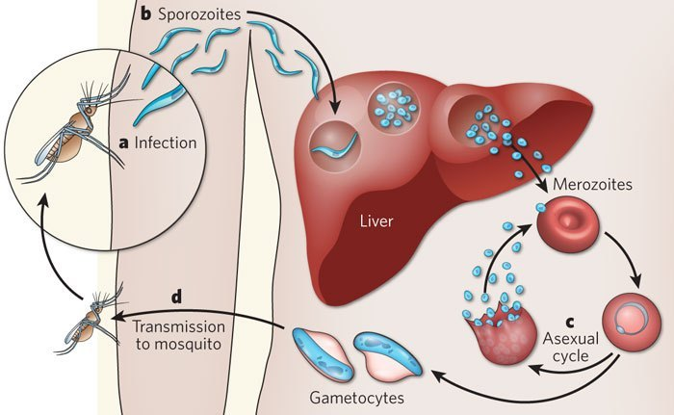

Slide 4


Slide 5
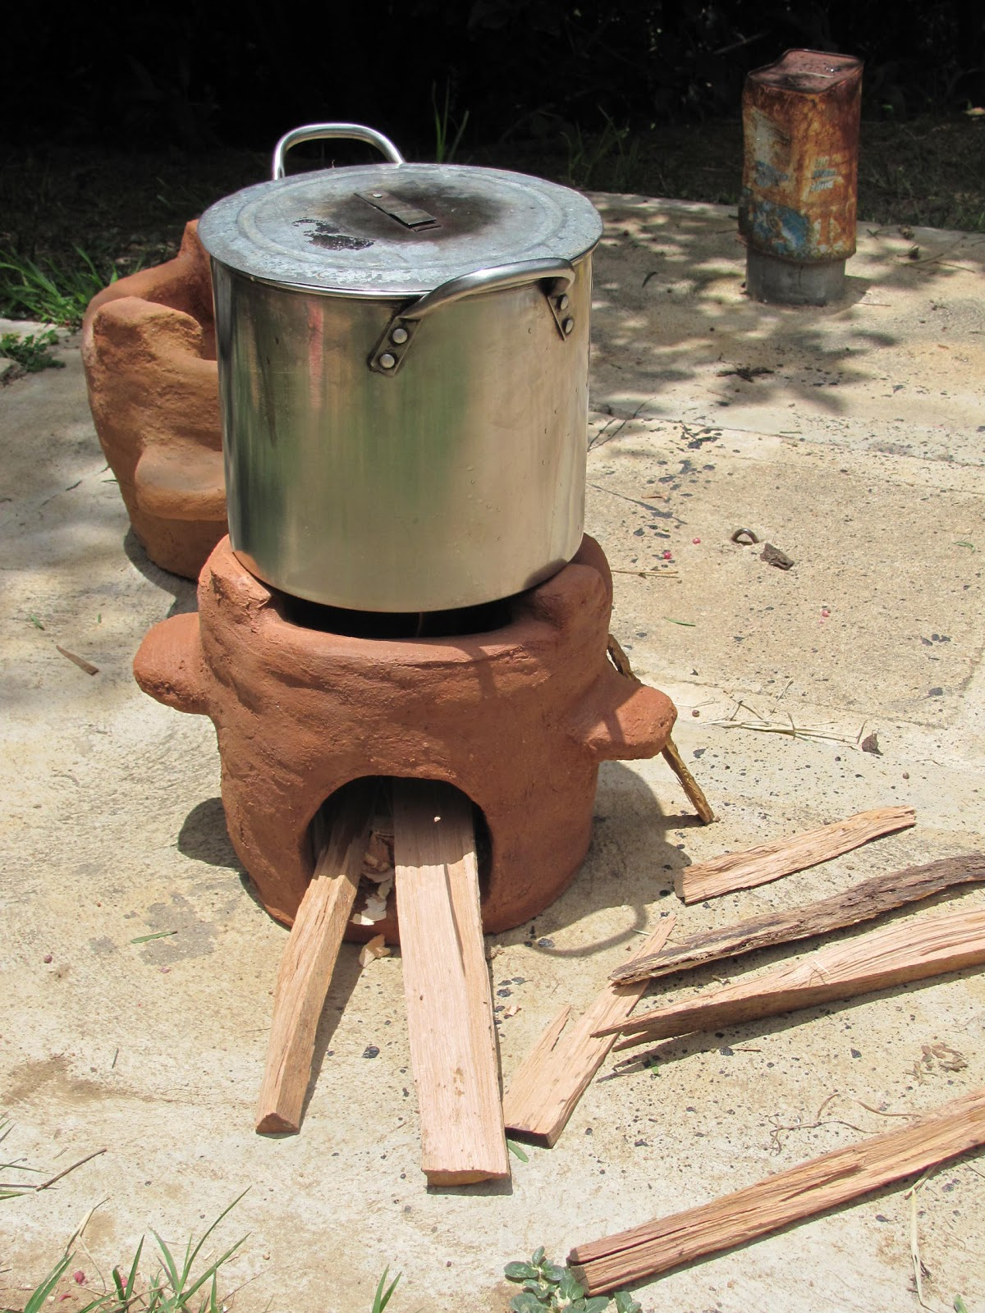
Existing Product: Clean Stove
Any positive effects measured in first year of use, disappear in second year
1/3 of stoves developed don’t use clean fuels
Stoves used inappropriately and irregularly
Problems with maintenance and reliability
Do not suit cooking practices of targeted cultural groups
Source: ‘Up In Smoke’ 2016

Slide 6
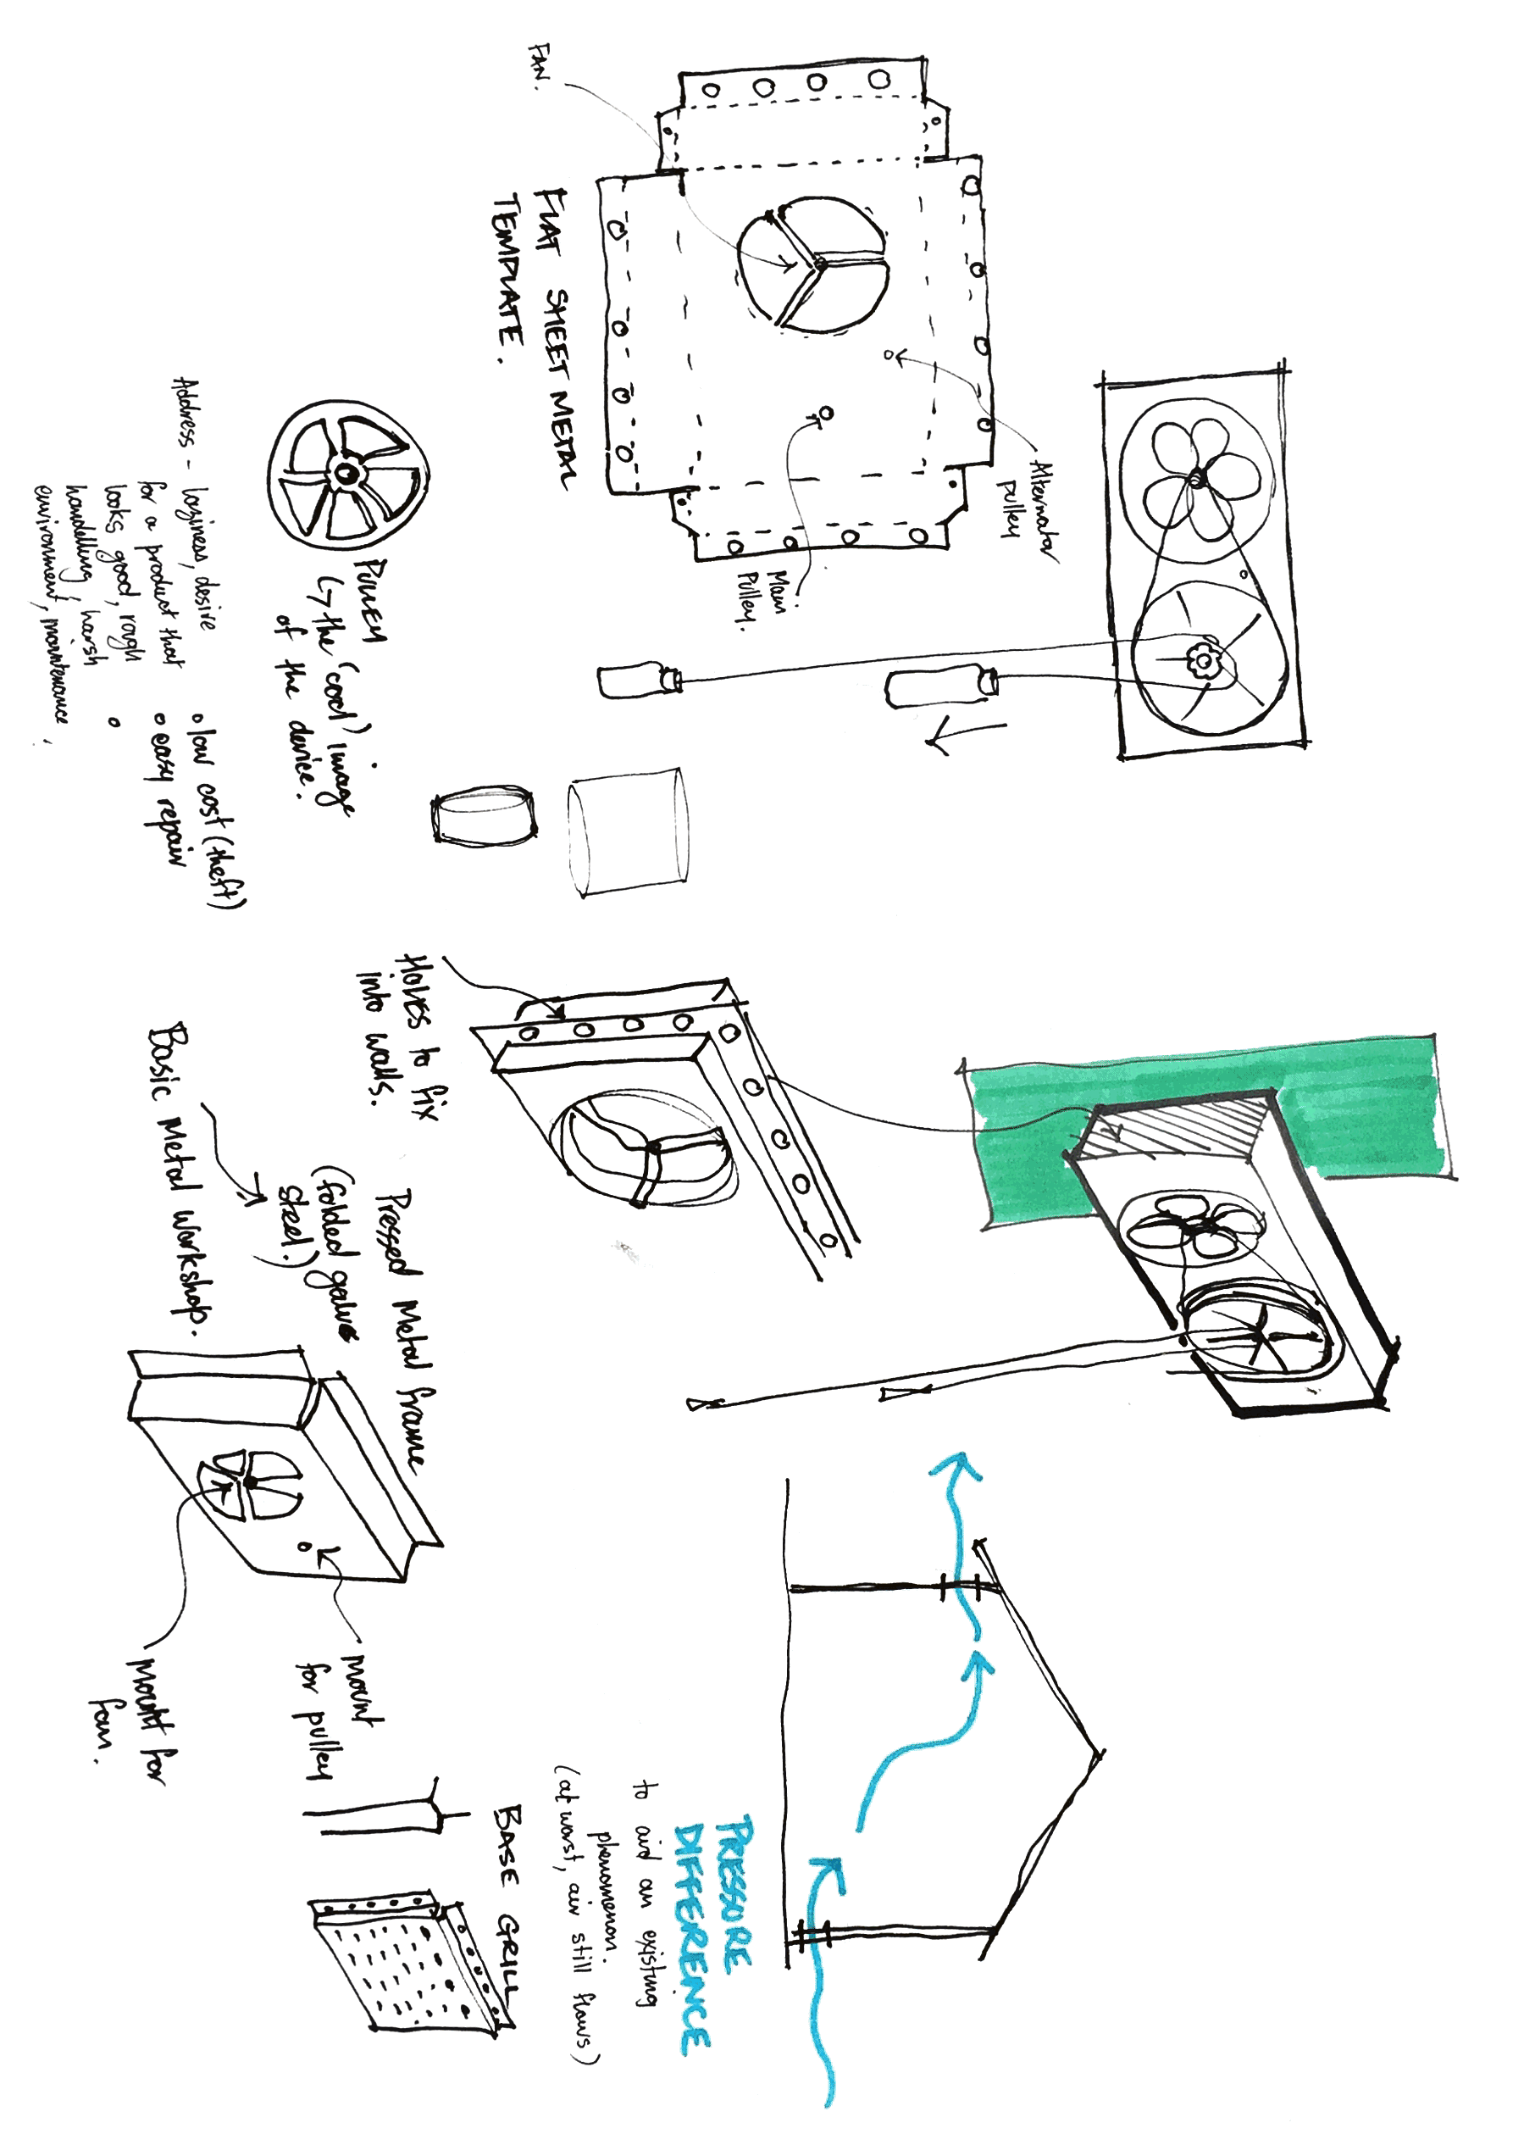
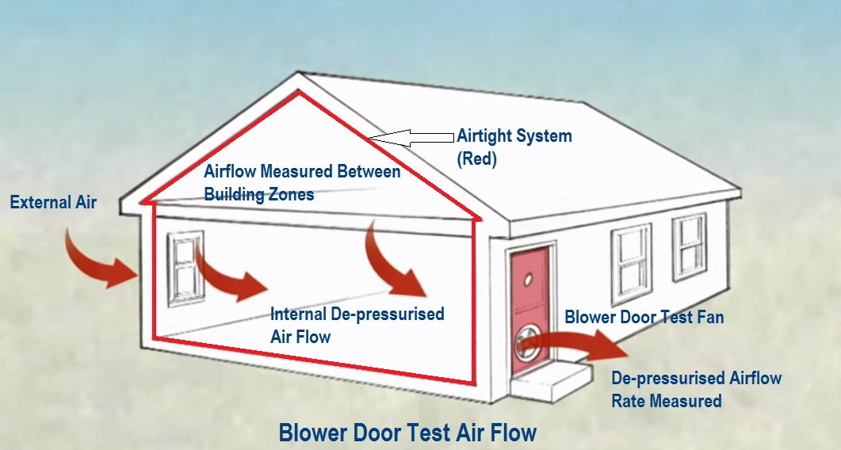
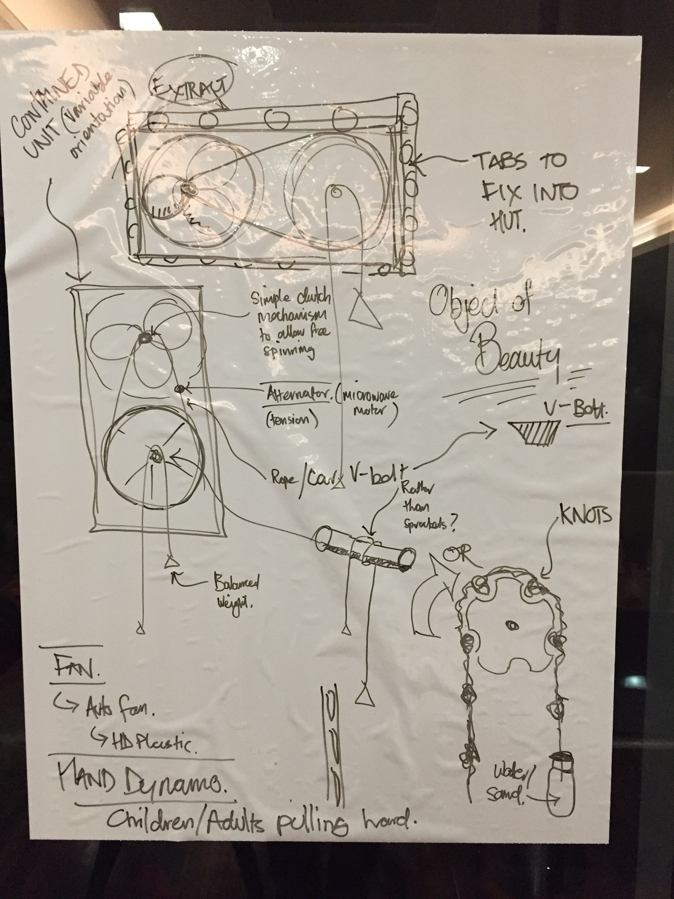
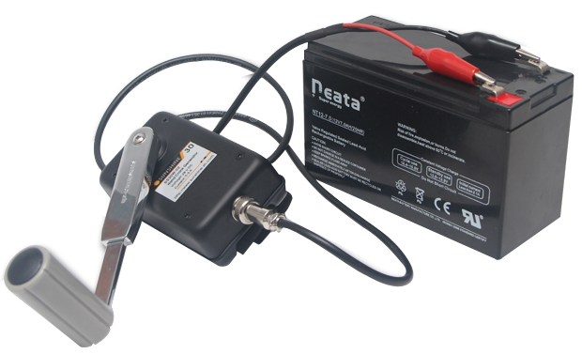
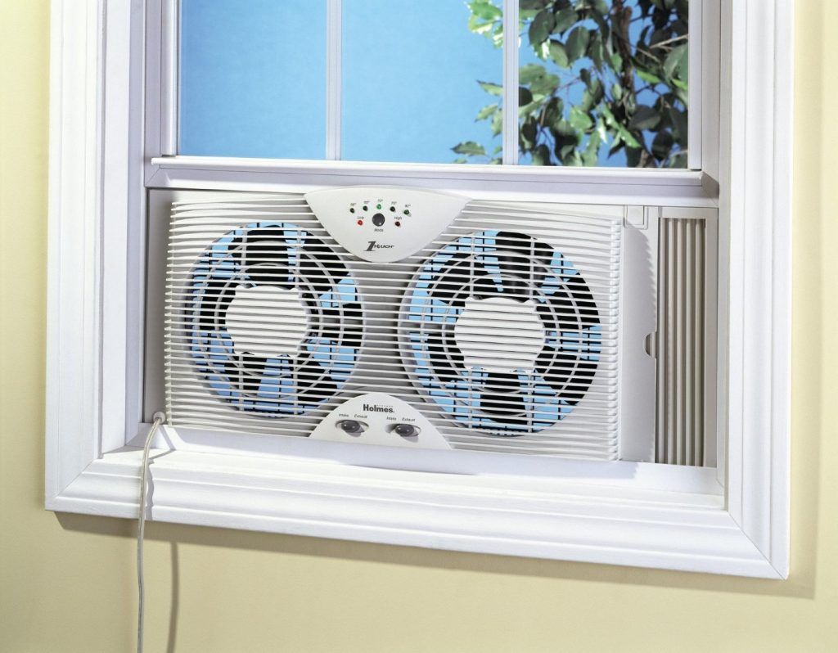
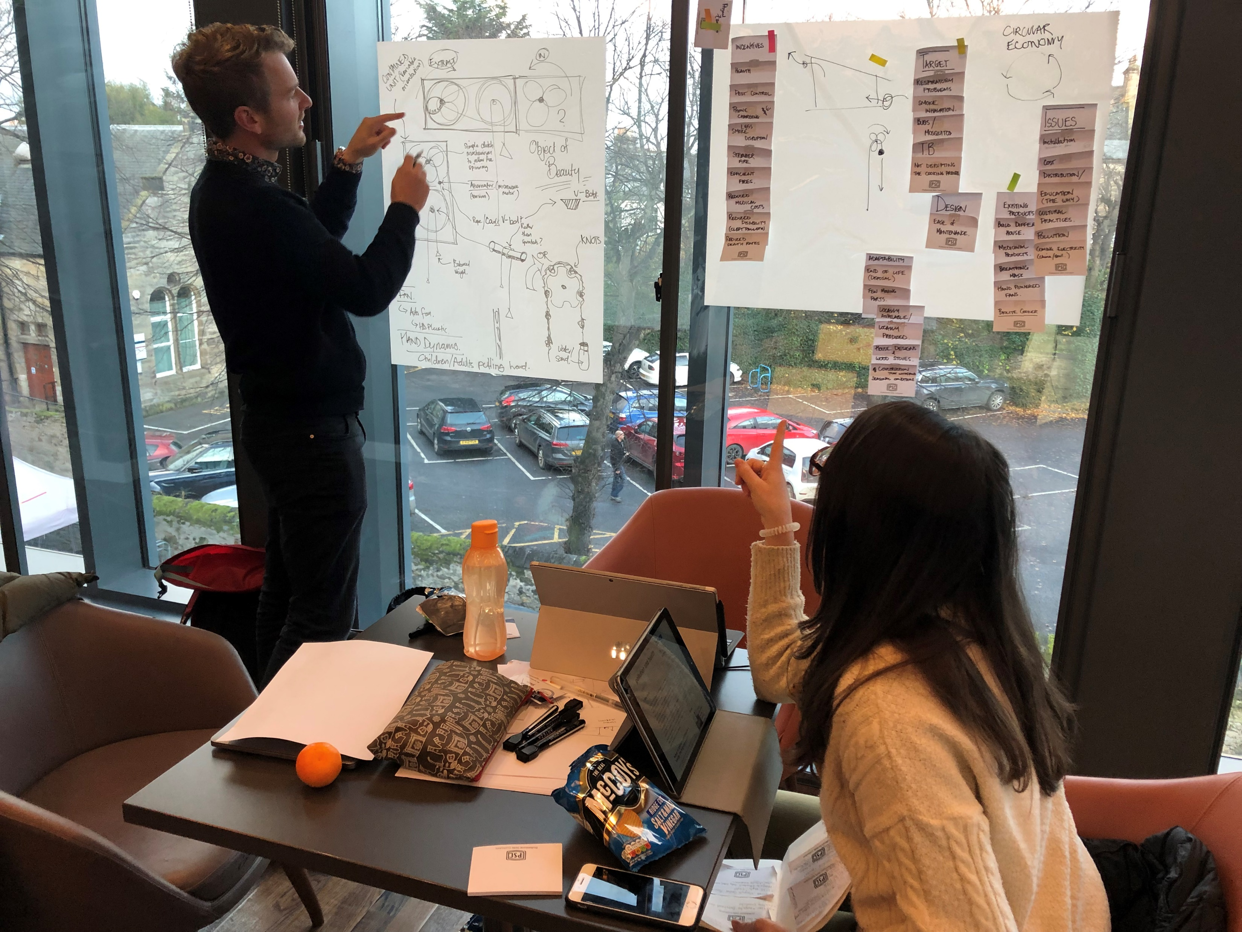
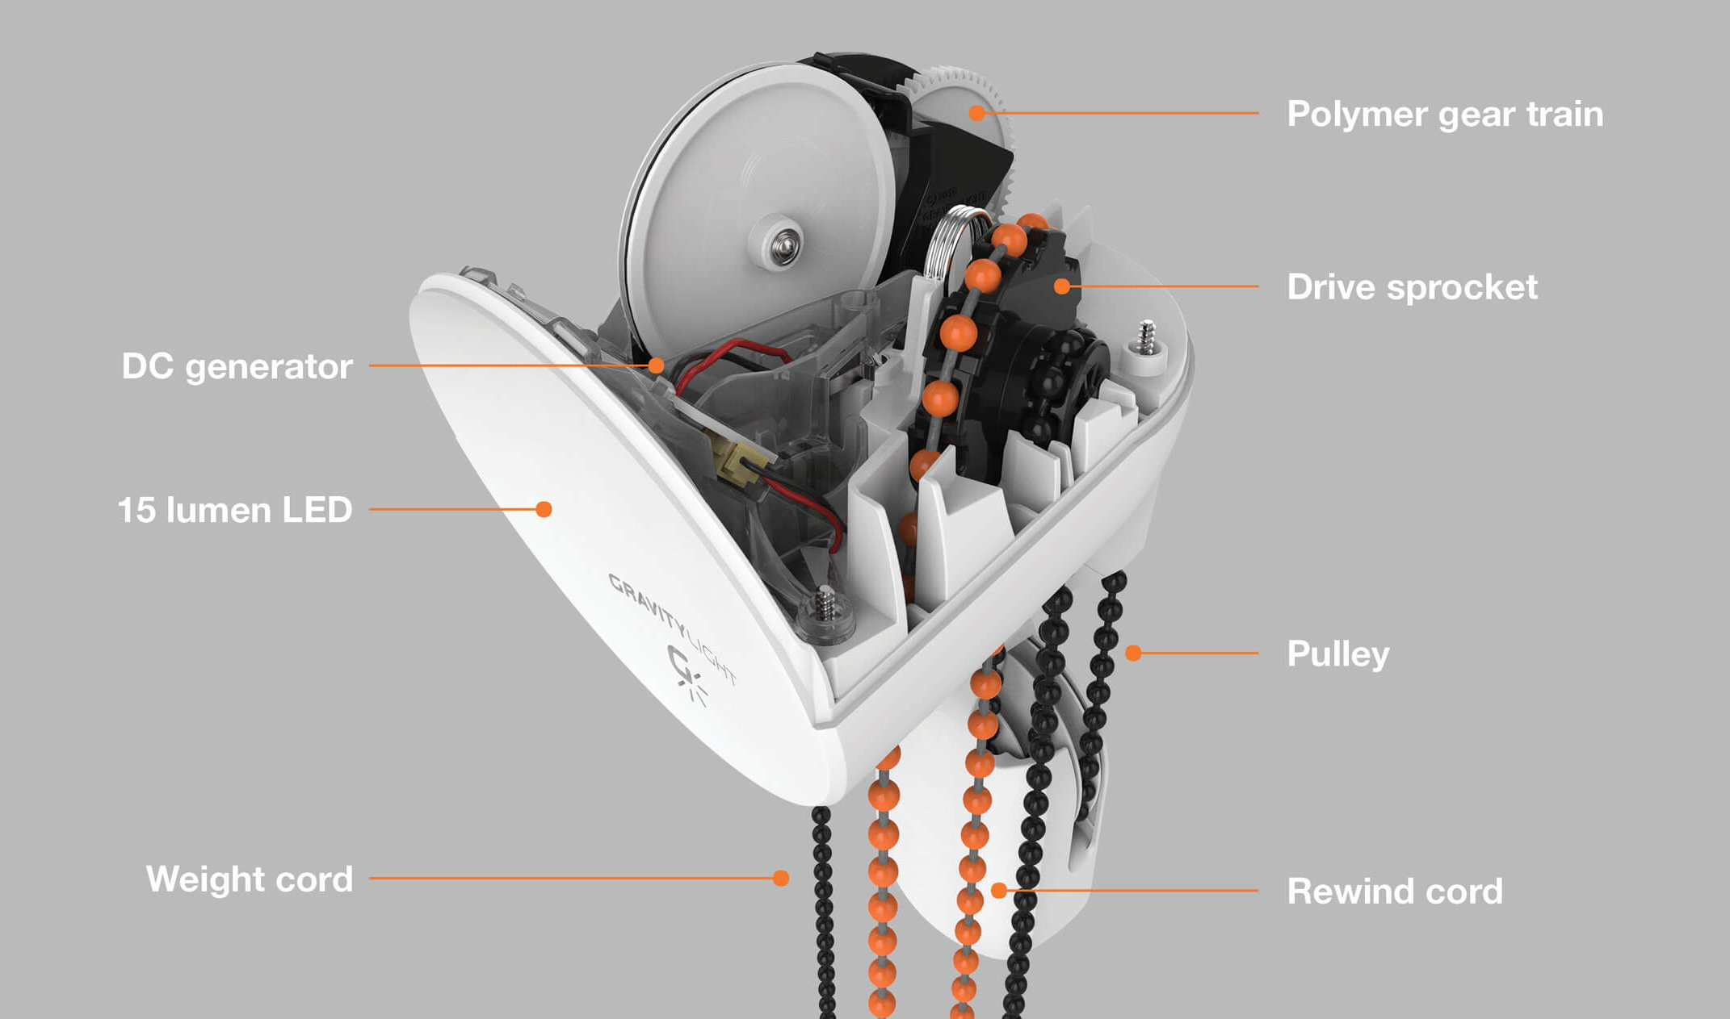

Slide 7
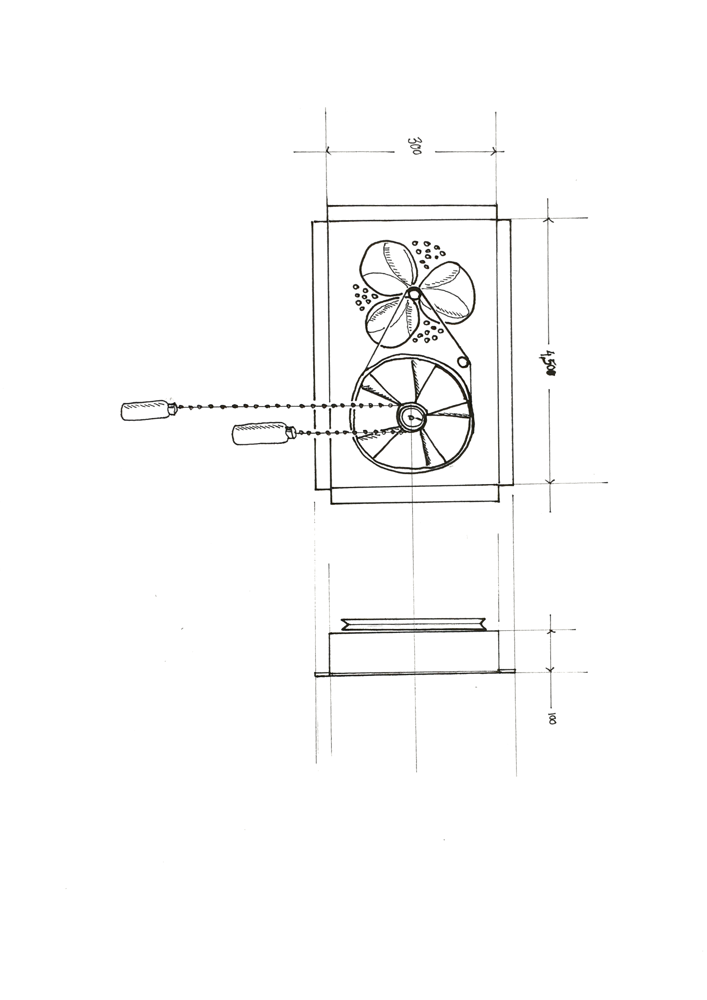
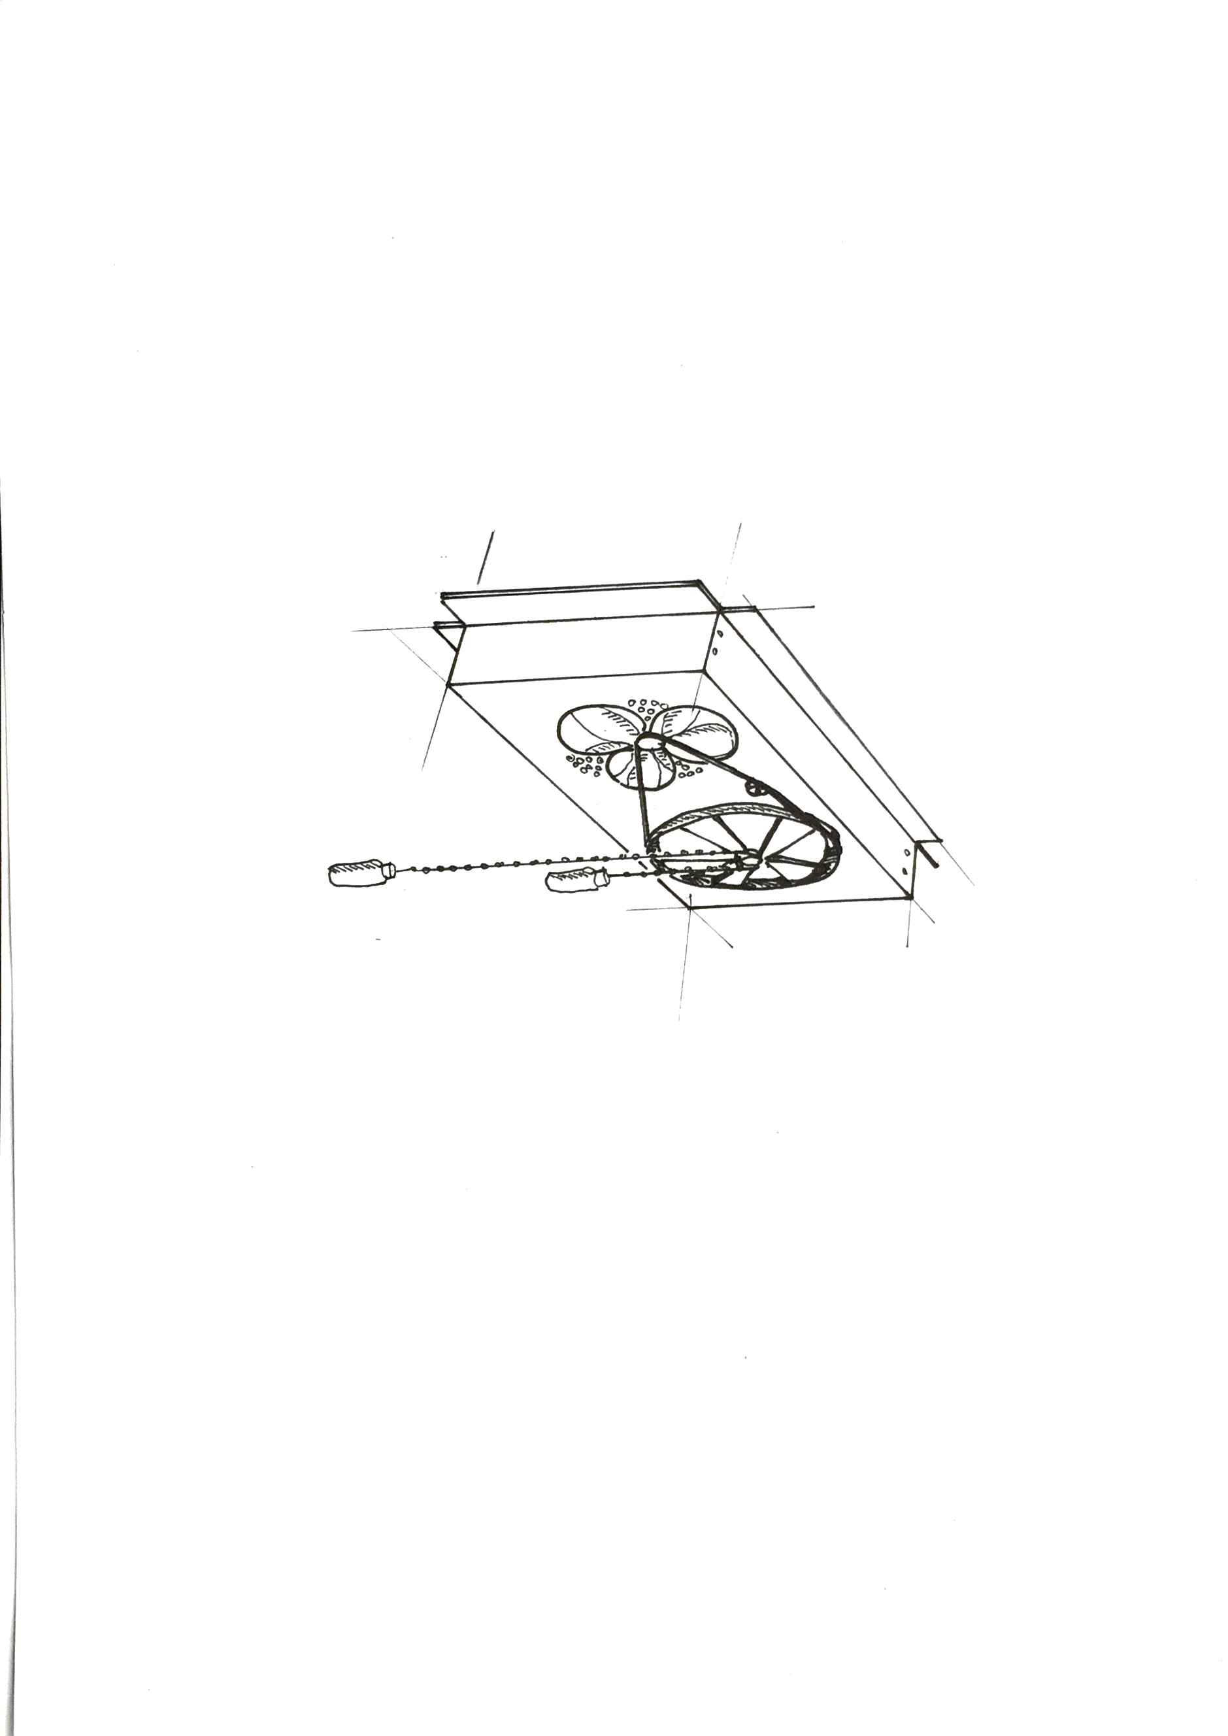

Slide 8
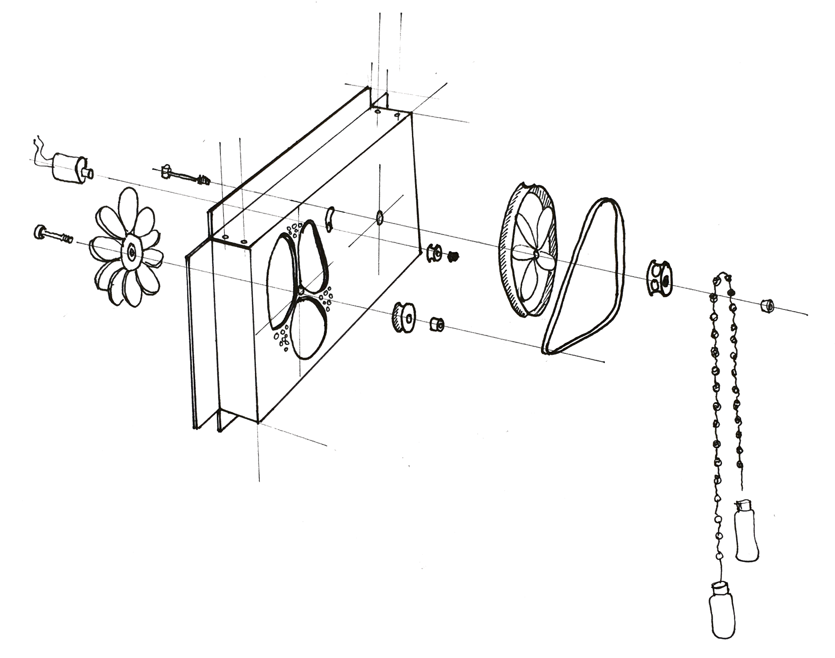

Slide 9
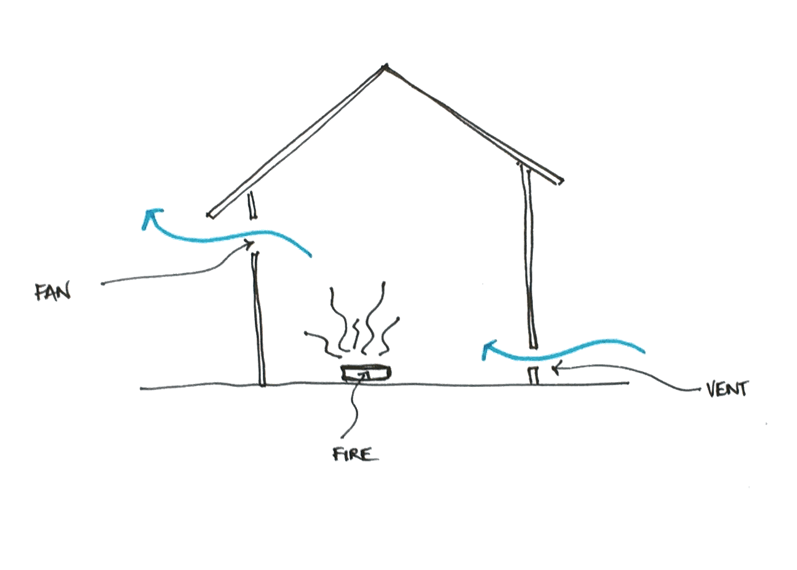

Slide 10

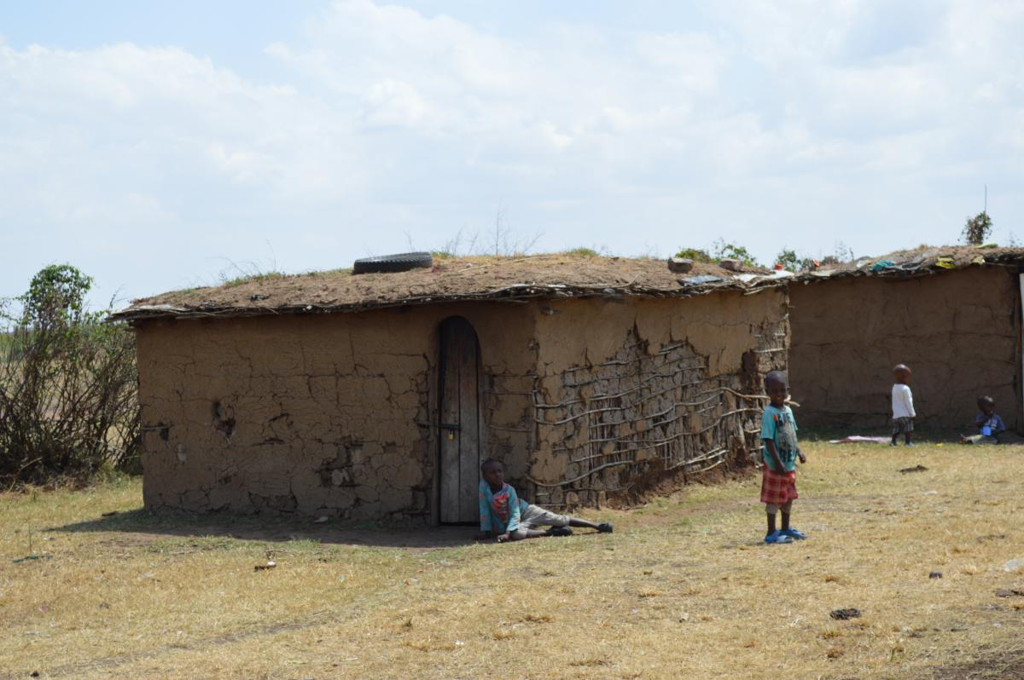
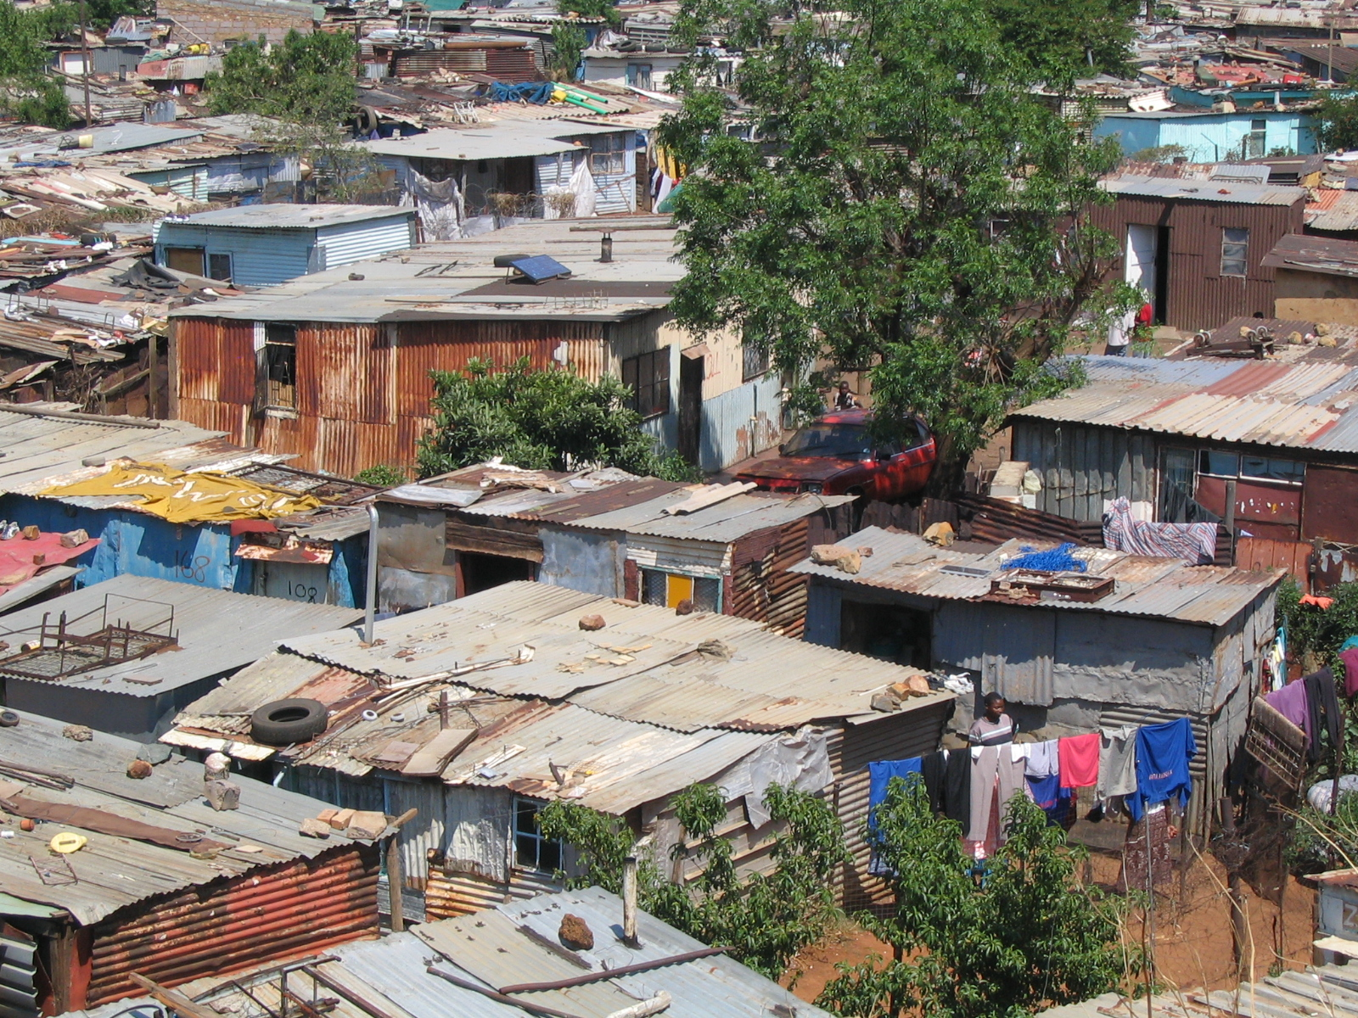
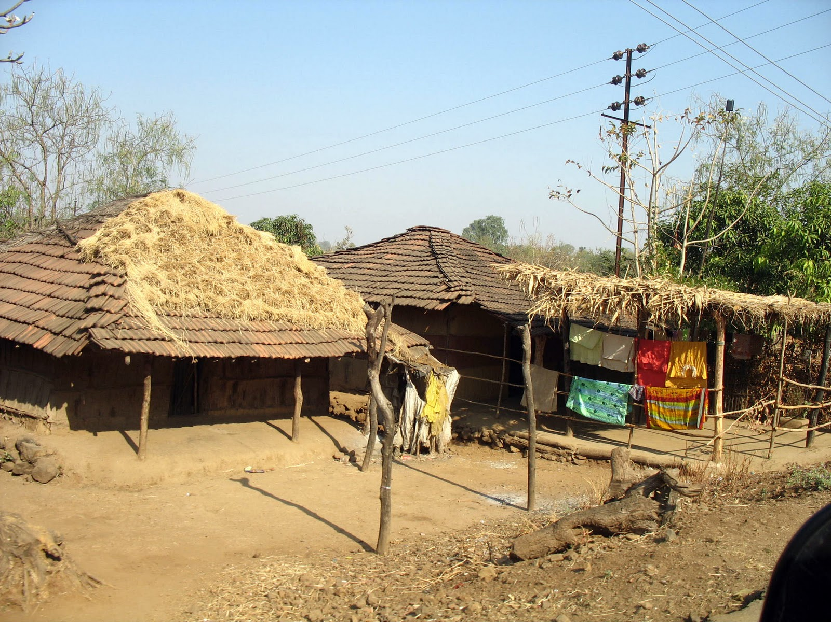

Home Integration

Slide 11

Market Opportunity
$413MILLION
In government, foundation, and corporate funds
1.3THOUSAND
Partner organisations
28MILLION
Cookstoves distributed in first 5 years
100MILLION
Cookstoves distributed by 2020
Source: Washington Post 2015

Slide 12
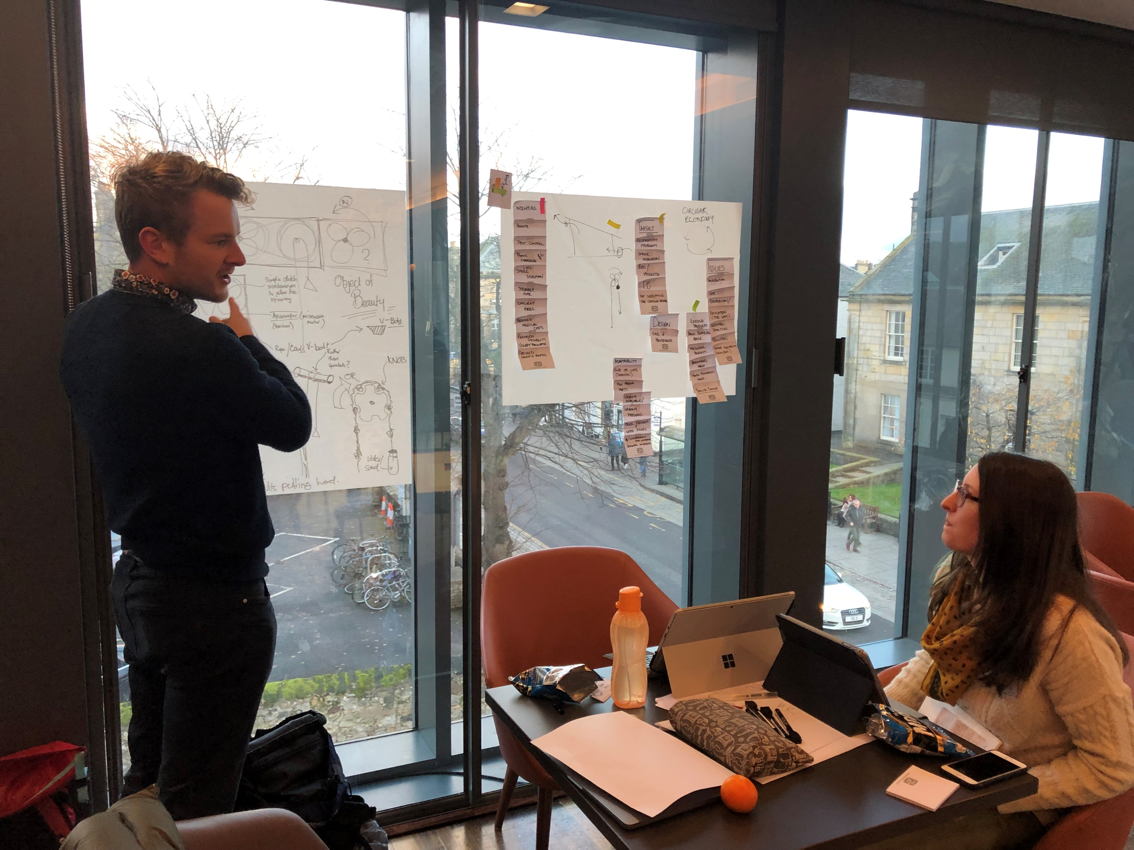
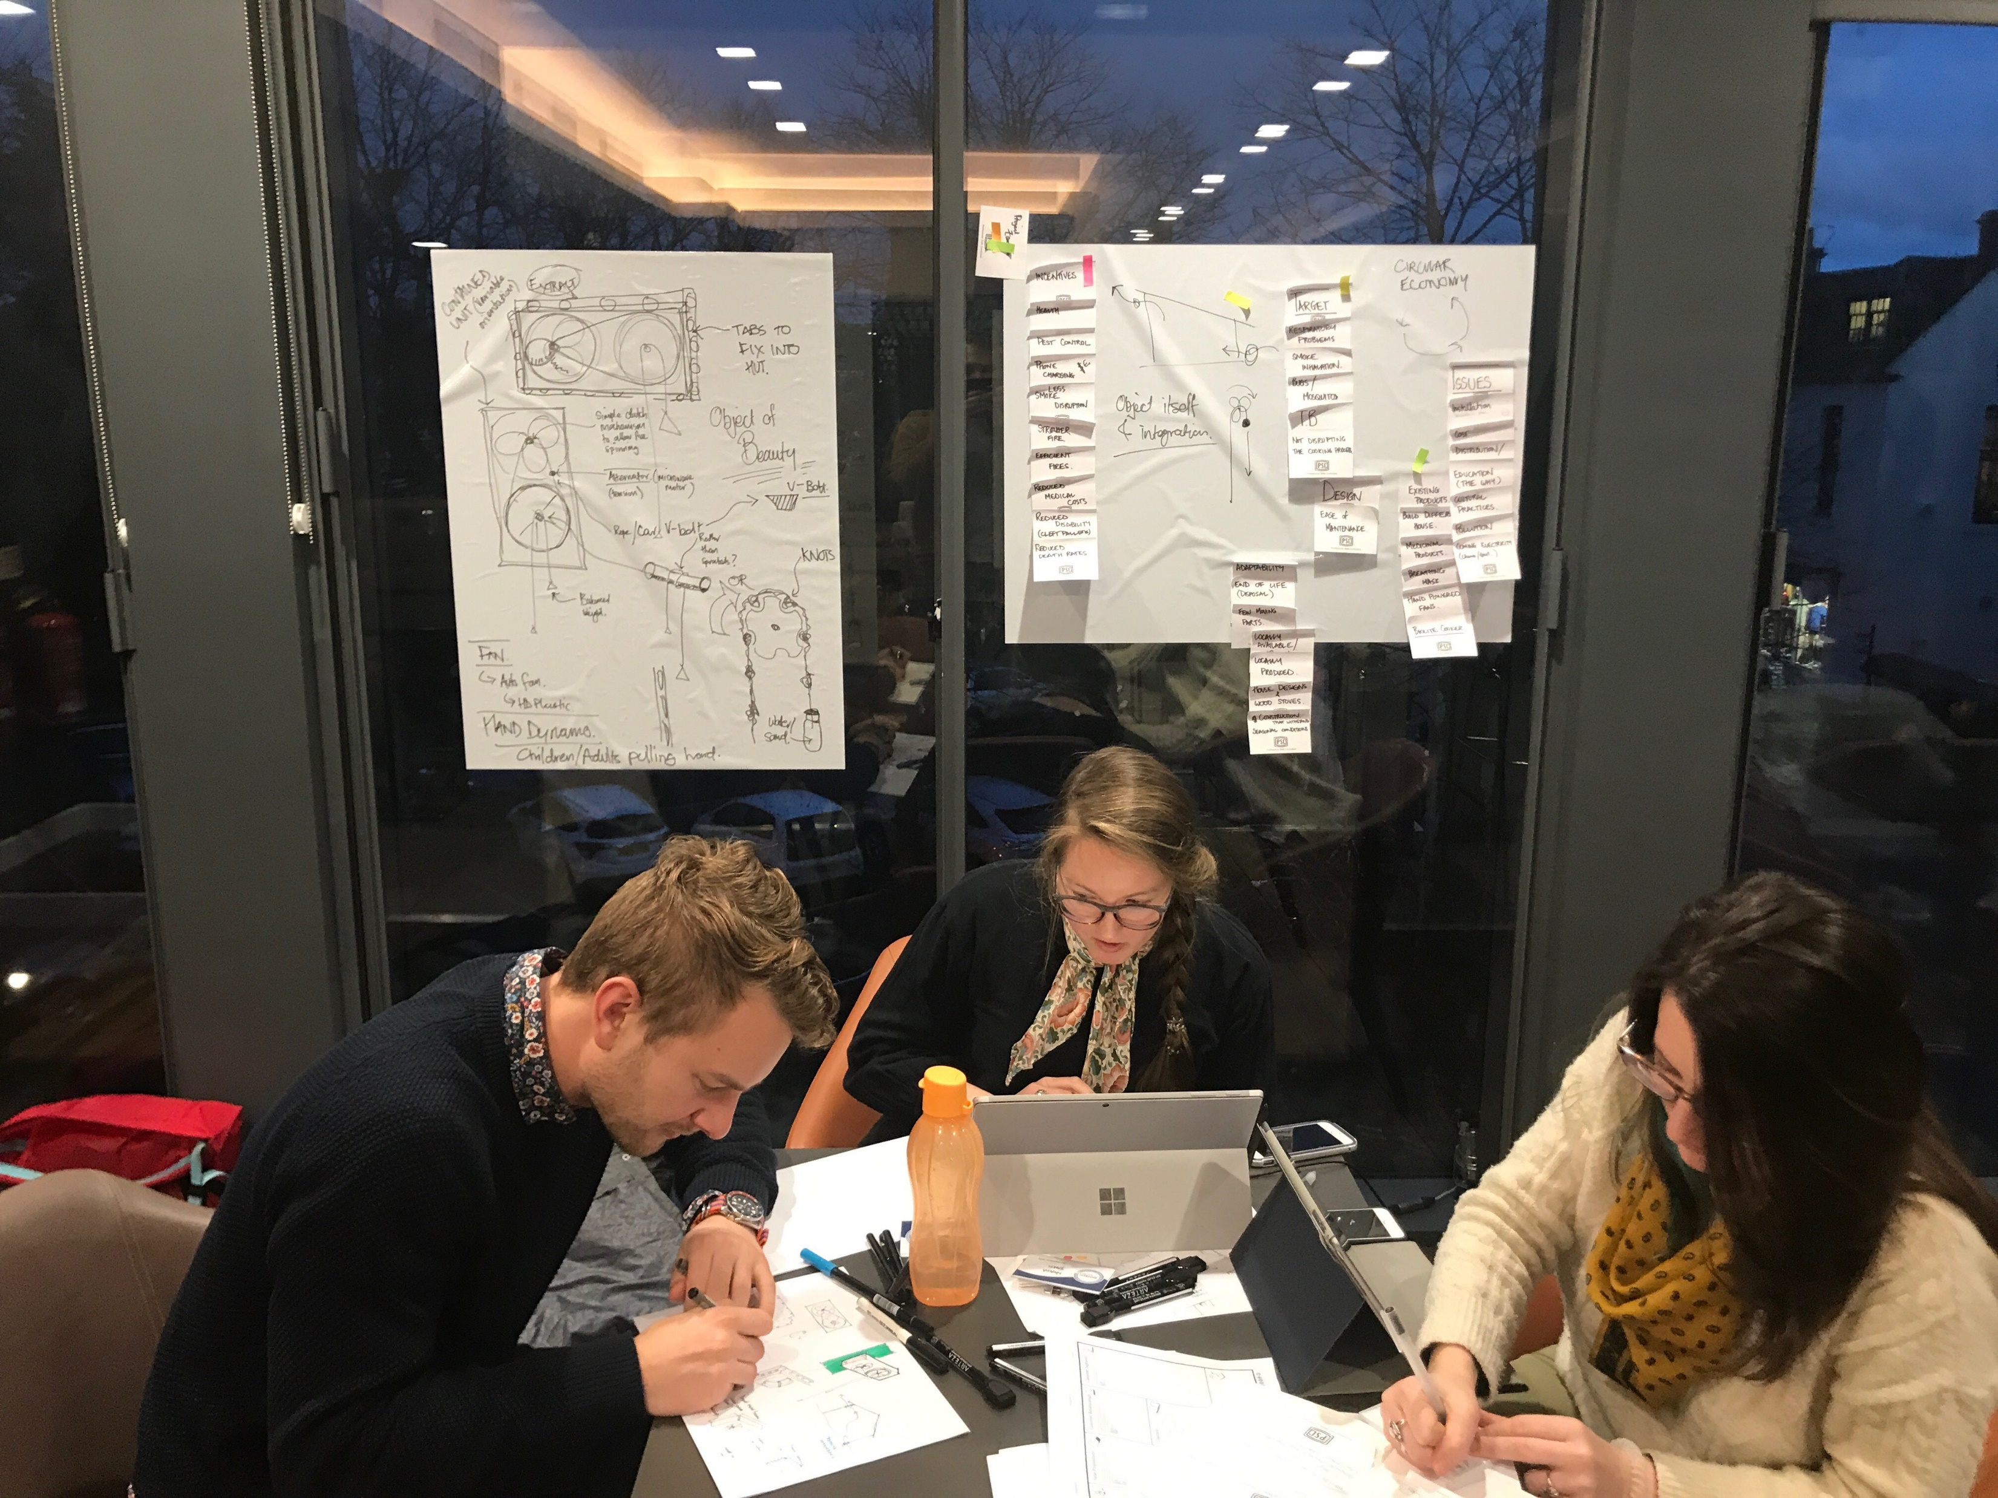
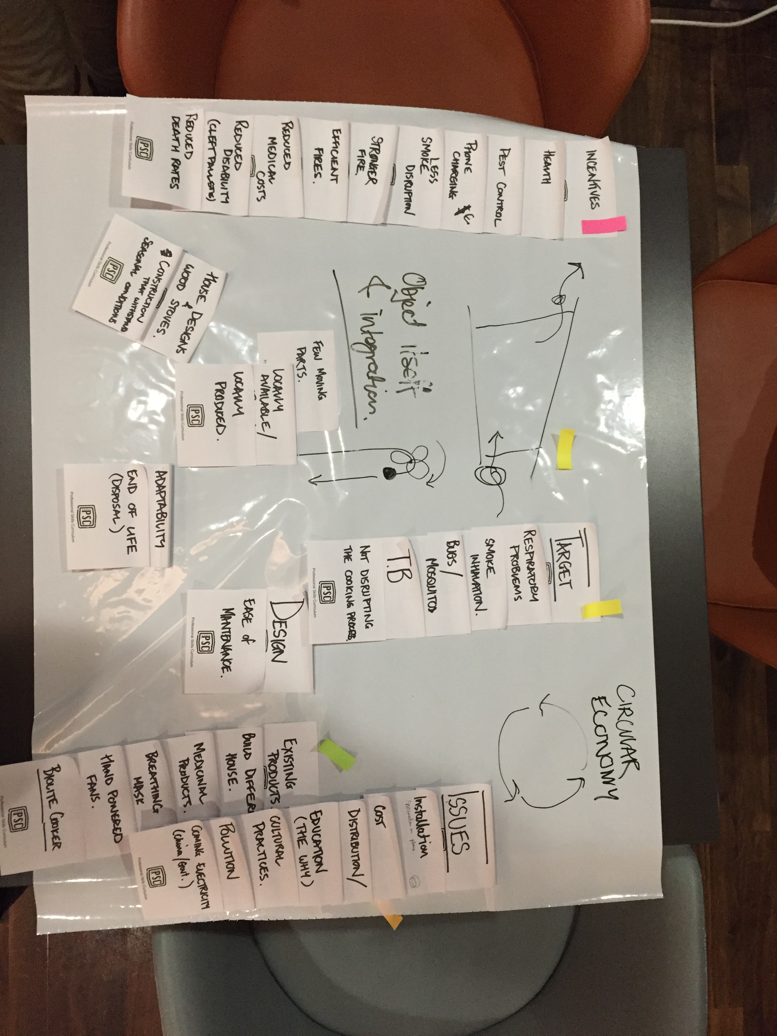
Our Process

Slide 13
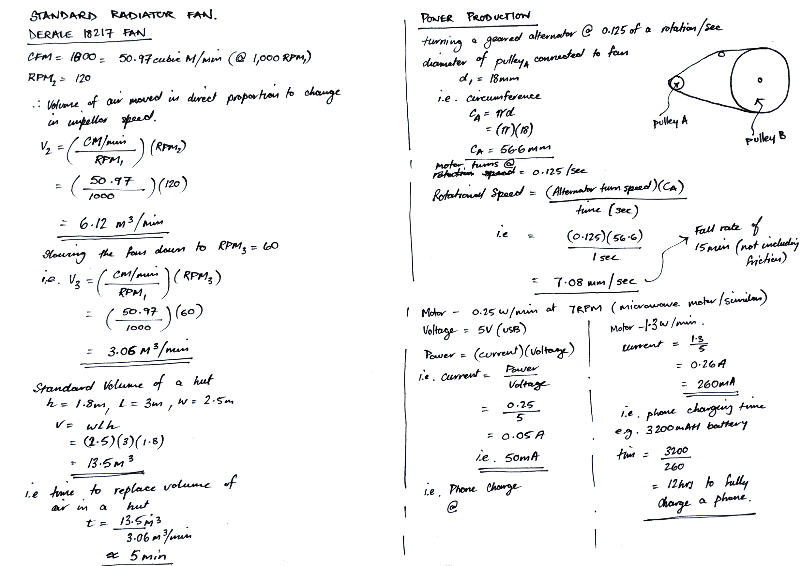
Relevant Calculations

Slide 14
Cost Breakdown
Item | Production Process/Source | Cost Estimate
Housing | Folded and cut galvanized steel | $8-10
Fan | Automotive radiator fan (new or salvaged) | $2-3
Main Pulley | Custom manufactured/adaptation of existing product | $4-5
Smaller Pulleys | Purchased | $0.25
Generator | Microwave motor or similar | $1-3
V-Belt | Automotive belt | $0.25
Rope | Purchased | $0.50
Bottles/Weights | Purchased | $0.25
Total |  | $20-30
Note: Prices dependent on volume ordered and country of manufacture

